Slide 1

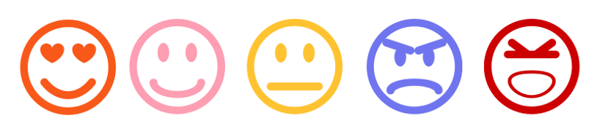
Sentiment Analysis – A Comparative Study
Presentation By Neerajdattu Dudam (101179017) Teja Mallireddy(101180616)
Supervisor: Dr. Longwei Wang
April 21st, 2025

Slide 2
Inspiration and Objective
Inspiration: To deepen our understanding of Natural Language Processing by exploring various sentiment analysis techniques. Driven by the need to compare traditional and modern approaches for practical sentiment classification.
Objective: To implement and evaluate lexicon-based, machine learning, and deep learning models for sentiment analysis. To develop a comparative analysis of diverse models and feature extraction techniques on balanced datasets.
Key Goals:
Implement and assess lexicon-based and classical ML sentiment classifiers.
Build and evaluate deep learning models including CNNs, LSTMs, and transformers.
Explore the effect of different feature engineering techniques like TF-IDF, Word2Vec, and GloVe.
Provide a comprehensive performance comparison to guide future sentiment analysis approaches.

Slide 3
Presentation Outline
Introduction
Text Preprocessing
Lexicon and Machine Learning
Deep Learning
Workflow
Data
Experiments
Results
Conclusions and Future Directions
References

Slide 4
Introduction
Explosion of Textual Data: In today's digital age, massive amounts of text are generated daily from social media, reviews, blogs, and feedback systems, making manual analysis impractical.
Importance of Sentiment Analysis: A key NLP technique, sentiment analysis helps automatically determine the emotional tone—positive, negative, or neutral—embedded in textual content.
Applications Across Domains: Beyond education, sentiment analysis is used in business for customer reviews, in politics for public opinion mining, and in healthcare for analyzing patient feedback.
Evolution of Techniques: The field has evolved from lexicon-based methods like VADER to machine learning models such as Naive Bayes and SVMs, and now to advanced deep learning and transformer-based models like BERT and GPT.

Slide 5
Text Preprocessing
Level 1: Basic Cleaning
Lowercasing: Converts all text to lowercase for uniformity.
Punctuation Removal: Deletes unnecessary punctuation (e.g., ! ? . ,).
Stop Word Removal: Removes common words like "the", "is", "and" that add little meaning.
Lemmatization: Reduces words to their dictionary form (e.g., “running” → “run”).
Tokenization: Splits text into individual words or tokens.

Slide 6
Text Preprocessing
Level 2: Feature Extraction
Bag of Words (BoW): Counts word occurrences without considering order.
TF-IDF: Weights words based on importance (more frequent in one doc, less common across corpus).
N-grams: Captures unigrams (single words), bigrams (word pairs), and trigrams (word triplets) to provide more contextual information.

Slide 7
Text Preprocessing
Level 3: Embedding Representations
Word2Vec: A predictive model that learns word embeddings by training a shallow neural network to predict a word based on its context (CBOW) or vice versa (Skip-gram). Words that appear in similar contexts are placed closer together in the vector space.
GloVe: A count-based model that learns embeddings by analyzing global word co-occurrence statistics. Convert words into dense vectors capturing meaning and similarity. It captures relationships like analogies (e.g., king - man + woman ≈ queen).
Sentence Embeddings: Represent entire sentences (e.g., using Universal Sentence Encoder).

Slide 8

Lexicon and Machine Learning

Slide 9

Lexicon and Machine Learning
Lexicon Based
Do not require training on labeled data.
Rely on predefined sentiment lexicons where each word is associated with a sentiment score.
Sentiment of a sentence or document is calculated based on the aggregate scores of the words it contains.
Simple, interpretable, and useful for domains where labeled data is scarce.
VADER =>
$$Compound Score= \frac{\sum_{i}{s_{i}}}{\sqrt{\sum_{i}{s_{i}^{2}+ α}}}$$

Slide 10
Lexicon and Machine Learning
Machine Learning Based
Require labeled data for training models to learn sentiment patterns.
Convert text into numerical features using techniques like CountVectorizer or TF-IDF.
Learn patterns and decision boundaries using algorithms like:
Naive Bayes
Logistic Regression
Support Vector Machines (SVM)
Decision Tree / Random Forest
Can generalize better than lexicon methods on large, diverse datasets.
More flexible and customizable but may require more computational resources.

Slide 11
Deep Learning
Deep Learning Based
Deep learning models automatically learn feature representations from raw text and excel at capturing complex semantic and contextual relationships.
These models work well with large datasets and can generalize better across diverse linguistic patterns.
Unlike traditional ML models, they do not rely on manual feature engineering.
Models Implemented:
LSTM, GRU, BiLSTM – Sequence models for capturing temporal context.
CNN with N-Grams – Detects local patterns like “not good”.
BERT, GPT – Transformer models with deep contextual understanding.
Capture word order, syntactic structure, and long-term dependencies.
Require high computational resources and longer training times but yield superior performance.

Slide 12
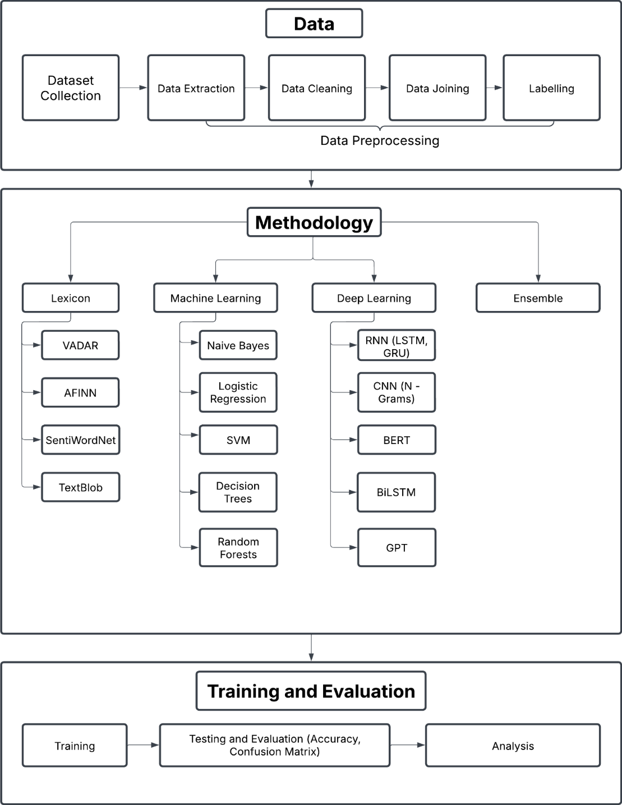
Workflow

Slide 13
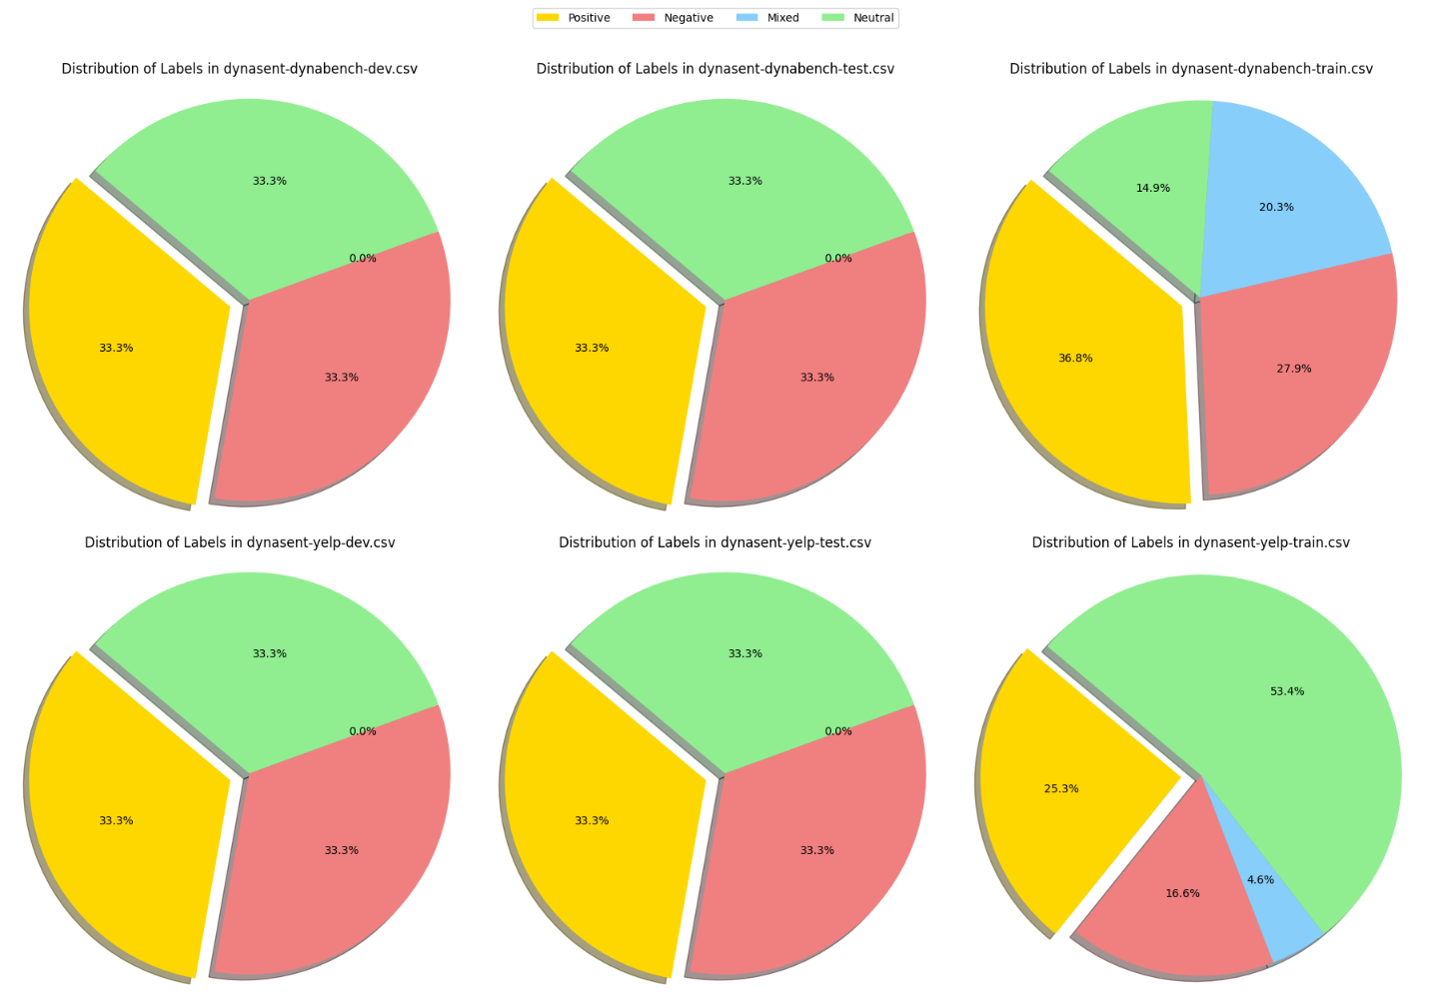
Data

Slide 14
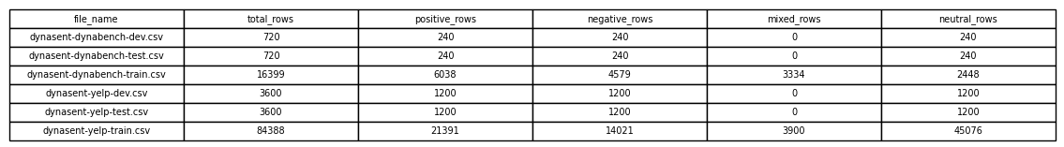
Data
File_name | Total_rows | Positive | Negative | Neutral
Yelp_train | 42063 | 14021 | 14021 | 14021
Yelp_test | 3600 | 1200 | 1200 | 1200
Yelp_val | 3600 | 1200 | 1200 | 1200
dynabench_train | 7344 | 2448 | 2448 | 2448
dynabench_test | 720 | 240 | 240 | 240
dynabench_val | 720 | 240 | 240 | 240
combined_train | 49407 | 16469 | 16469 | 16469
combined_test | 1440 | 480 | 480 | 480
combined_val | 1440 | 480 | 480 | 480

Slide 15

Experiments
Exp 1: Using VADER
The first experiment employed the VADER (Valence Aware Dictionary and sEntiment Reasoner), which
is a lexicon and rule-based sentiment analysis tool, particularly optimized for microtext like tweets. Each
word in the VADER lexicon is assigned a valence score between -4 (most negative) and +4 (most
positive).
$$Compound Score= \frac{\sum_{i}{s_{i}}}{\sqrt{\sum_{i}{s_{i}^{2}+ α}}}$$
Here, s_{i} is the valence score of the i-th word and 𝛼 is a normalization factor (default is 15).

Slide 16
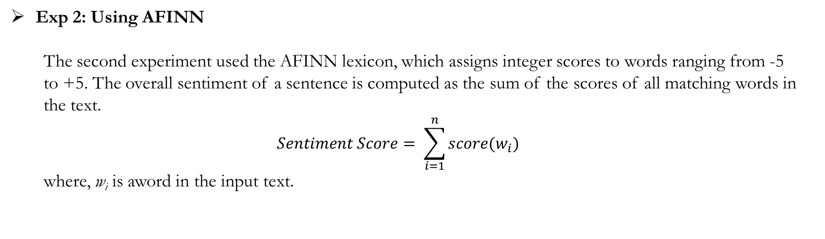
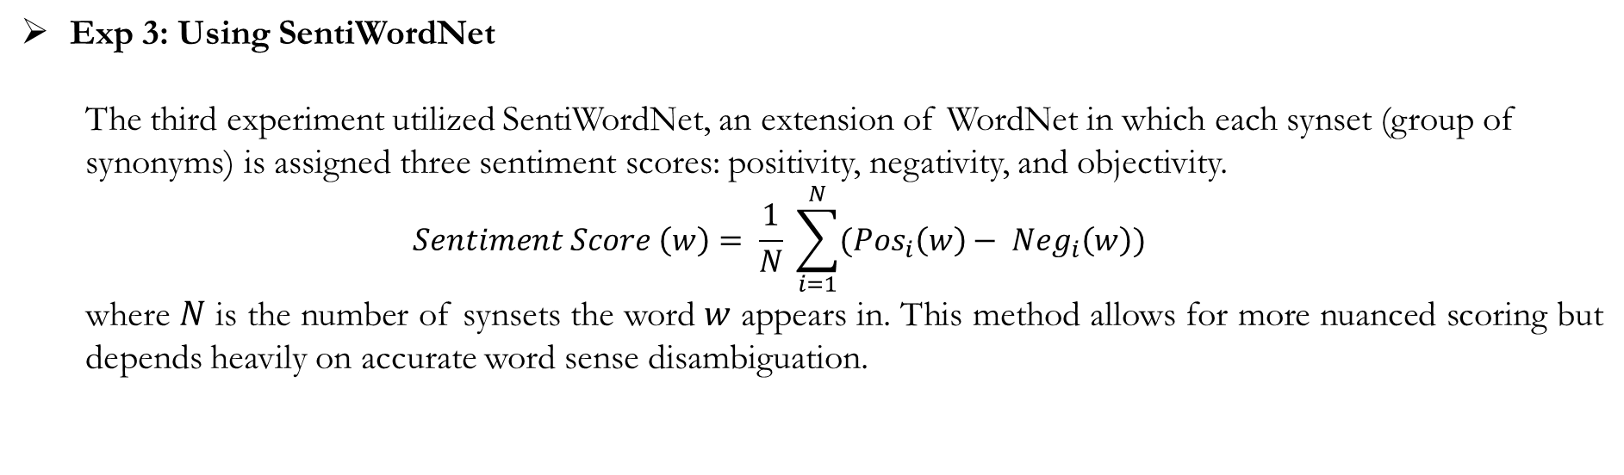
Experiments
Exp 2: Using AFINN
The second experiment used the AFINN lexicon, which assigns integer scores to words ranging from -5
to +5. The overall sentiment of a sentence is computed as the sum of the scores of all matching words in
the text.
$$Sentiment Score= \sum_{i=1}^{n}{score(w_{i})}$$
where, w_{i} is aword in the input text.
Exp 3: Using SentiWordNet
The third experiment utilized SentiWordNet, an extension of WordNet in which each synset (group of
synonyms) is assigned three sentiment scores: positivity, negativity, and objectivity.
$$Sentiment Score \left(w\right)= \frac{1}{N} \sum_{i=1}^{N}{({Pos}_{i}\left(w\right)− {Neg}_{i}\left(w\right))}$$
where 𝑁 is the number of synsets the word 𝑤 appears in. This method allows for more nuanced scoring but depends heavily on accurate word sense disambiguation.

Slide 17


Experiments
Exp 4: Using TextBlob
The fourth experiment applied TextBlob, a lexicon-based model that combines rule-based parsing and a
sentiment lexicon derived from Pattern and NLTK. It outputs two values: polarity (ranging from -1 to
+1) and subjectivity (ranging from 0 to 1). It's a machine learning based approach.
Exp 5: Naïve Bayes from Scratch
In this implementation, we manually computed the class priors, word likelihoods, and prediction probabilities. This approach provided a deep understanding of how the model works internally, including the impact of rare words and class imbalance.
$$\hat{y}={argmax}_{c} (\log{P\left(c\right)}+ \sum_{i=1}^{n}{log P(w_{i}|c)})$$
$$P\left(w_{i} | c\right)= \frac{N_{w_{i,c}}+1}{\sum_{j}{N_{w_{i,c}}+|V|}}$$
$$P\left(c, d\right)= \frac{P\left(c\right)\prod_{i=1}^{n}{P\left(w_{i} | c\right)}}{P\left(d\right)}$$

Slide 18
Experiments
Exp 6: Multinomial Naive Bayes with CountVectorizer
In this experiment, we implemented the Multinomial Naive Bayes classifier using CountVectorizer as the feature extractor. CountVectorizer tokenizes the text and creates a feature vector representing the frequency of each word in the document, without accounting for global document frequency.
Exp 7,8,9: Logistic Regression with Various Features
These experiments applied Logistic Regression with three different feature extraction methods. In Exp 7, word frequency was used directly, which performed poorly due to overemphasis on common terms. Exp 8 employed CountVectorizer, converting text into word occurrence vectors, effective for short texts. Exp 9 used TF-IDF, which improved performance by weighting words based on their importance across documents. Among the three, TF-IDF achieved the best results, highlighting the importance of feature selection in text classification.

Slide 19
Experiments
Exp 10: Random Forest Classifier with TF-IDF Features
The tenth experiment implemented a Random Forest classifier with TF-IDF features. Random Forests are ensemble methods that aggregate the predictions of multiple Decision Trees trained on bootstrapped subsets of the data, with random subsets of features considered at each split. This reduces variance and improves robustness. The final class prediction is made by majority voting across the individual trees.
Exp 11: Support Vector Machine (SVM) with TF-IDF Features
In the eleventh experiment, we implemented a Support Vector Machine (SVM) classifier using TF-IDF
between the classes. The decision function is defined as:
$$f\left(x\right)= w^{T}x+b$$

Slide 20

Experiments
Exp 12: Decision Tree Classifier with TF-IDF Features
Finally, The twelfth experiment utilized a Decision Tree Classifier, again with TF-IDF features. Decision Trees recursively split the dataset based on the feature that provides the highest information gain or minimizes Gini impurity. The Gini impurity at a node is defined as:
$$G\left(t\right)=1− \sum_{i=1}^{C}{p_{i}^{2}}$$

Slide 21
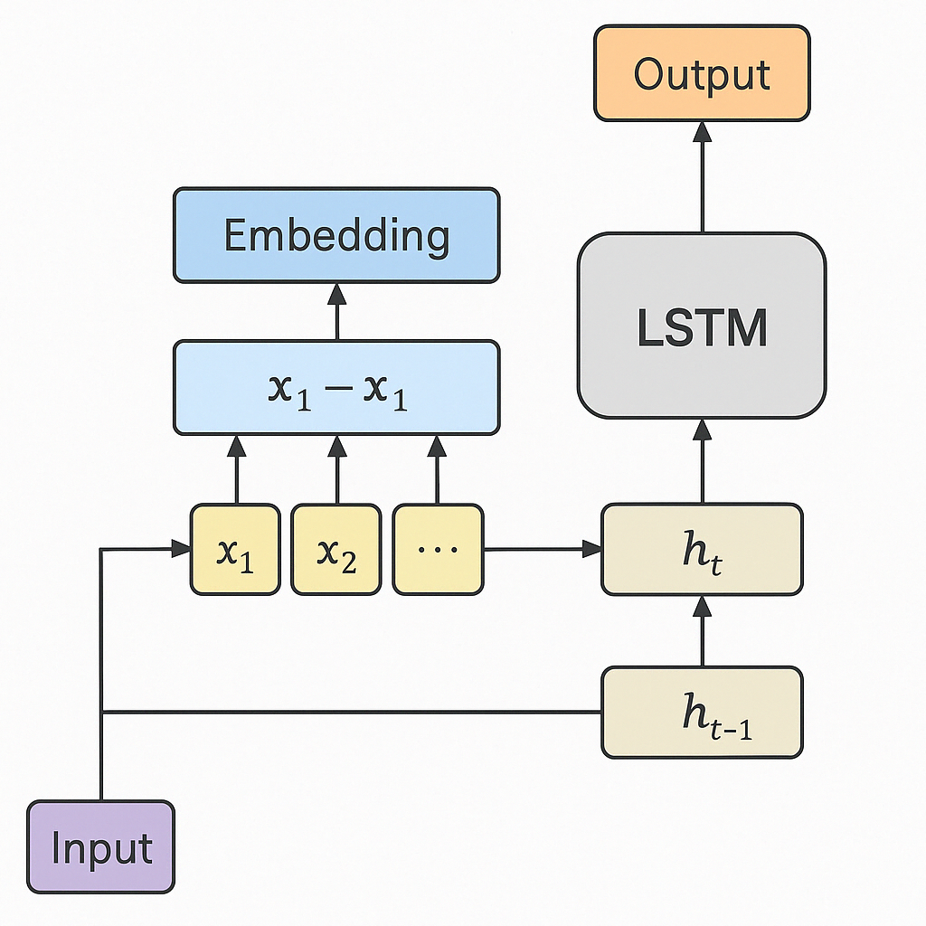
Experiments
Exp 13: LSTM (Long Short-Term Memory)
The thirteenth experiment implemented an LSTM (Long Short-Term Memory) network, a type of recurrent neural network (RNN) designed to capture long-term dependencies in text sequences. It uses gates to manage memory and retain important context. The architecture consisted of 300d GloVe embeddings, a 2-layer bidirectional LSTM (hidden size 256, dropout 0.5), and a fully connected layer for 3-class sentiment classification. The model was trained for 30 epochs using Adam (lr=0.0007, weight decay=1e-4) and CrossEntropyLoss on a combined Yelp and Dynabench dataset with a batch size of 128. The model performed well, especially on the Yelp dataset with an accuracy of 68%.
LSTM Architecture diagram

Slide 22
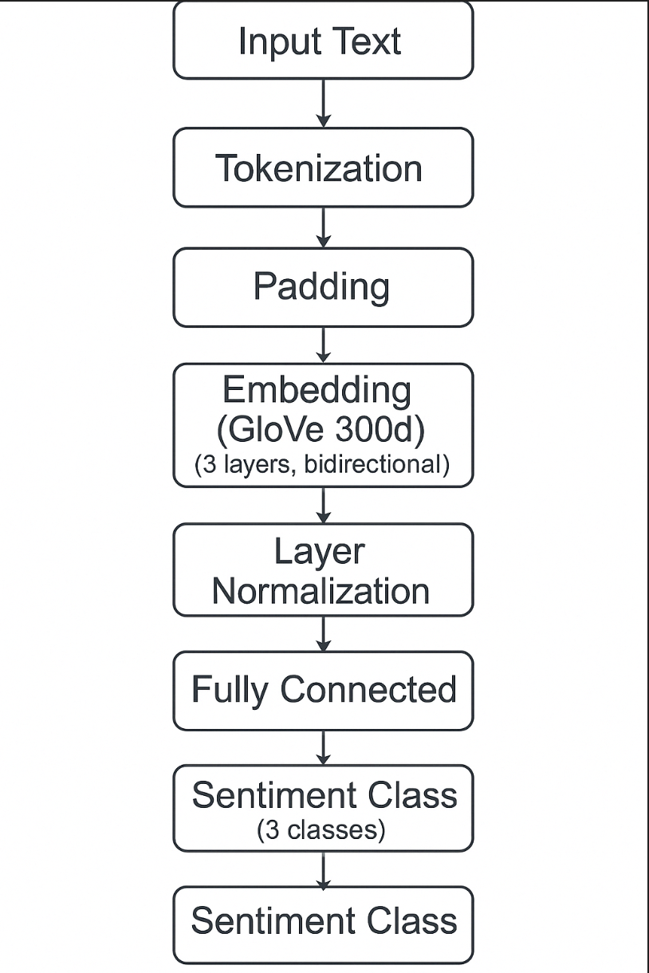
Experiments
Exp 14: Gated Recurrent Unit (GRU)
The fourteenth experiment used a Gated Recurrent Unit (GRU) network. GRUs simplify the LSTM architecture while maintaining similar performance. The architecture included 300-dimensional GloVe embeddings, followed by a two-layer bidirectional GRU with a hidden size of 256 and a dropout rate of 0.5. A fully connected layer was used for final prediction across three sentiment classes. The model was trained using the Adam optimizer (learning rate 0.0007, weight decay 1e-4) and CrossEntropyLoss, over 30 epochs with a batch size of 128 on the combined Yelp and Dynabench dataset. GRU achieved the highest Yelp dataset accuracy among RNNs at 69%, indicating its strength in sequence modeling with fewer parameters.
GRU Architecture diagram

Slide 23
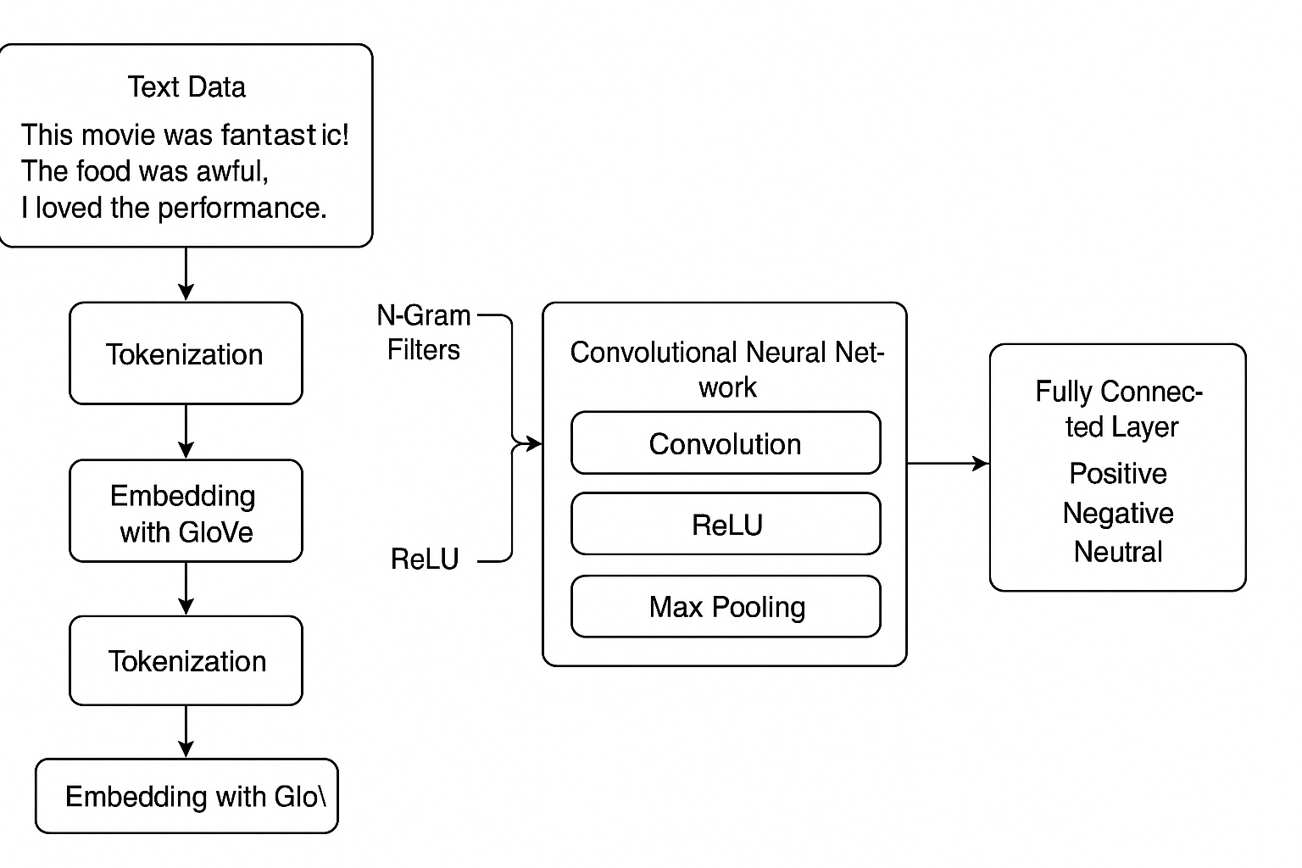
Experiments
Exp 15: N-GRAM (CNN with N-Grams)
The fifteenth experiment applied a CNN model with N-gram feature extraction. The use of N-grams allows the model to capture local patterns like “not good” or “very bad”. The model used 300-dimensional GloVe embeddings with 1D convolutional filters to capture unigram, bigram, and trigram patterns, followed by max pooling and a fully connected layer for classification. Training was done with the Adam optimizer (learning rate 0.0007, weight decay 1e-4) and CrossEntropyLoss for 30 epochs, using a batch size of 128 on the combined Yelp and Dynabench dataset. This CNN-based model achieved balanced performance across datasets, with a 67% accuracy on Yelp and 62% on the Combined dataset.
CNN with N-Gram Architecture diagram

Slide 24
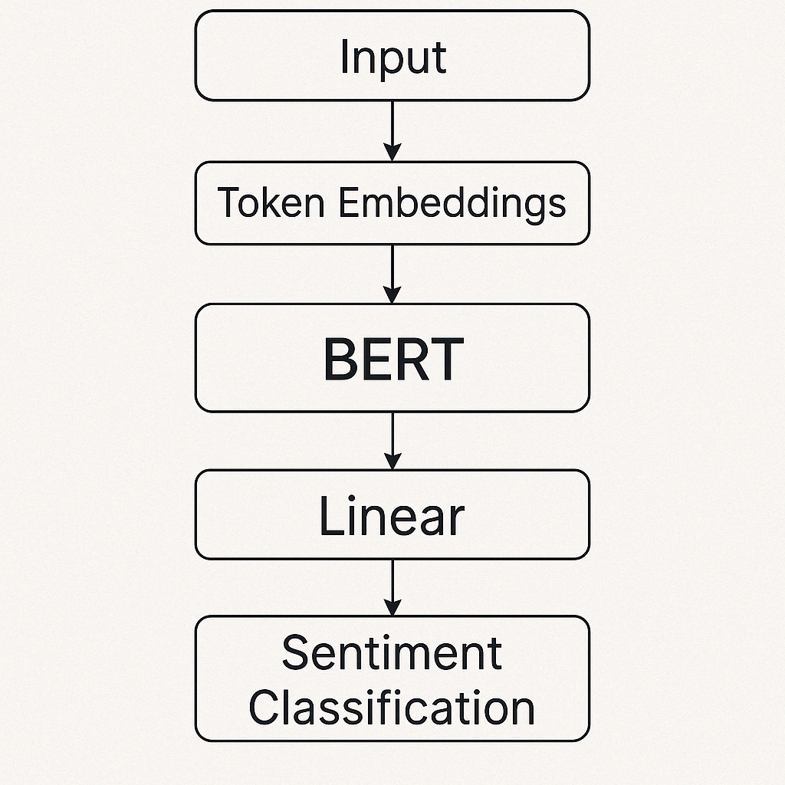
Experiments
Exp 16: BERT (Bidirectional Encoder Representations from Transformers)
The sixteenth experiment used the BERT (Bidirectional Encoder Representations from Transformers) model. It reads context from both directions and excels in capturing sentiment nuance. The architecture consisted of a pretrained BERT base model with 12 transformer layers, 768 hidden units, and 12 attention heads. A dropout layer and a fully connected classification head were added on top for 3-class sentiment prediction. The model was fine-tuned using the AdamW optimizer with learning rate scheduling and CrossEntropyLoss. Training was done for 4 epochs with a batch size of 16 on the combined Yelp and Dynabench dataset. BERT delivered top performance with 78% accuracy on Yelp and 70% on the Combined dataset.
BERT Architecture diagram

Slide 25
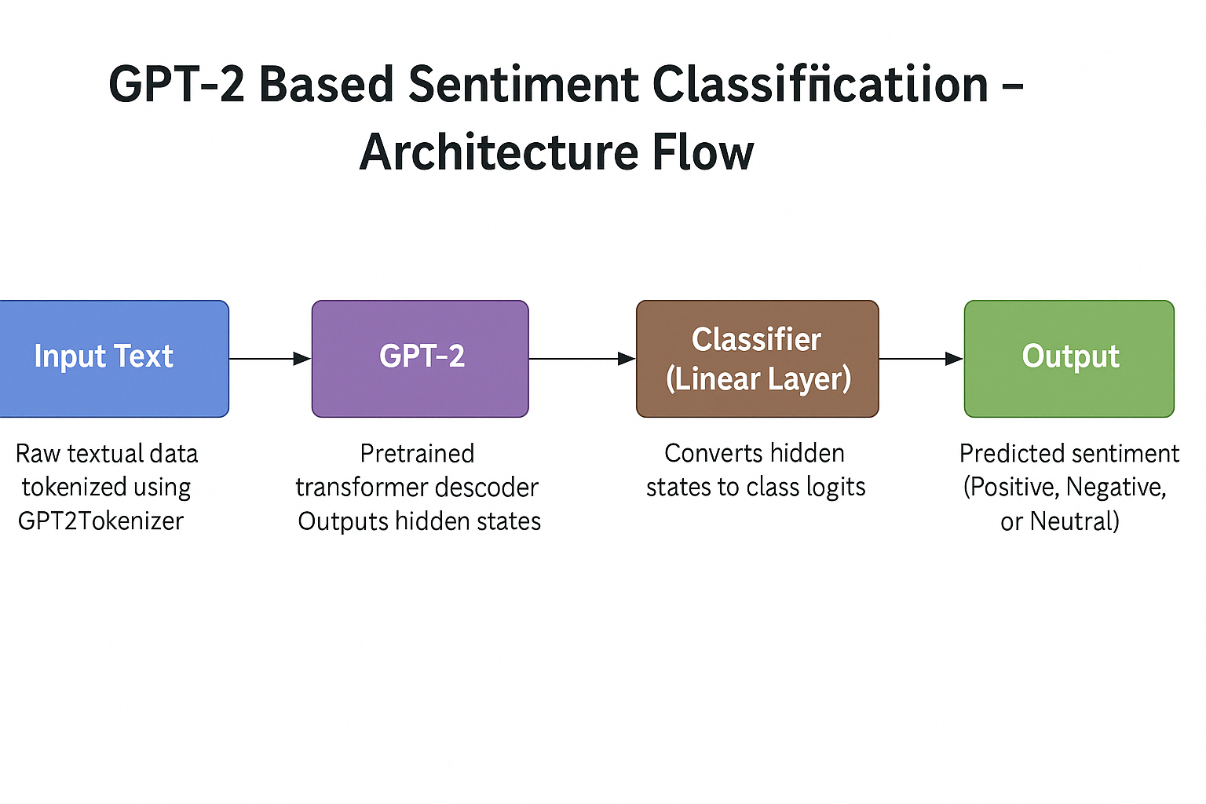
Experiments
Exp 17: GPT
The seventeenth experiment employed GPT, a transformer-based language model focused on generating and classifying text. The architecture included a pretrained GPT-2 base model with 12 decoder-only transformer layers, 768 hidden units, and 12 attention heads, followed by a dropout layer and a fully connected classification head for 3-class output. The model was fine-tuned using the AdamW optimizer with a linear learning rate scheduler and CrossEntropyLoss. It was trained for 4 epochs with a batch size of 16 on the combined Yelp and Dynabench dataset. When fine-tuned for sentiment analysis, GPT matched BERT's accuracy, showing strong generalization with 78% on Yelp and 70% on the Combined dataset.

Slide 26
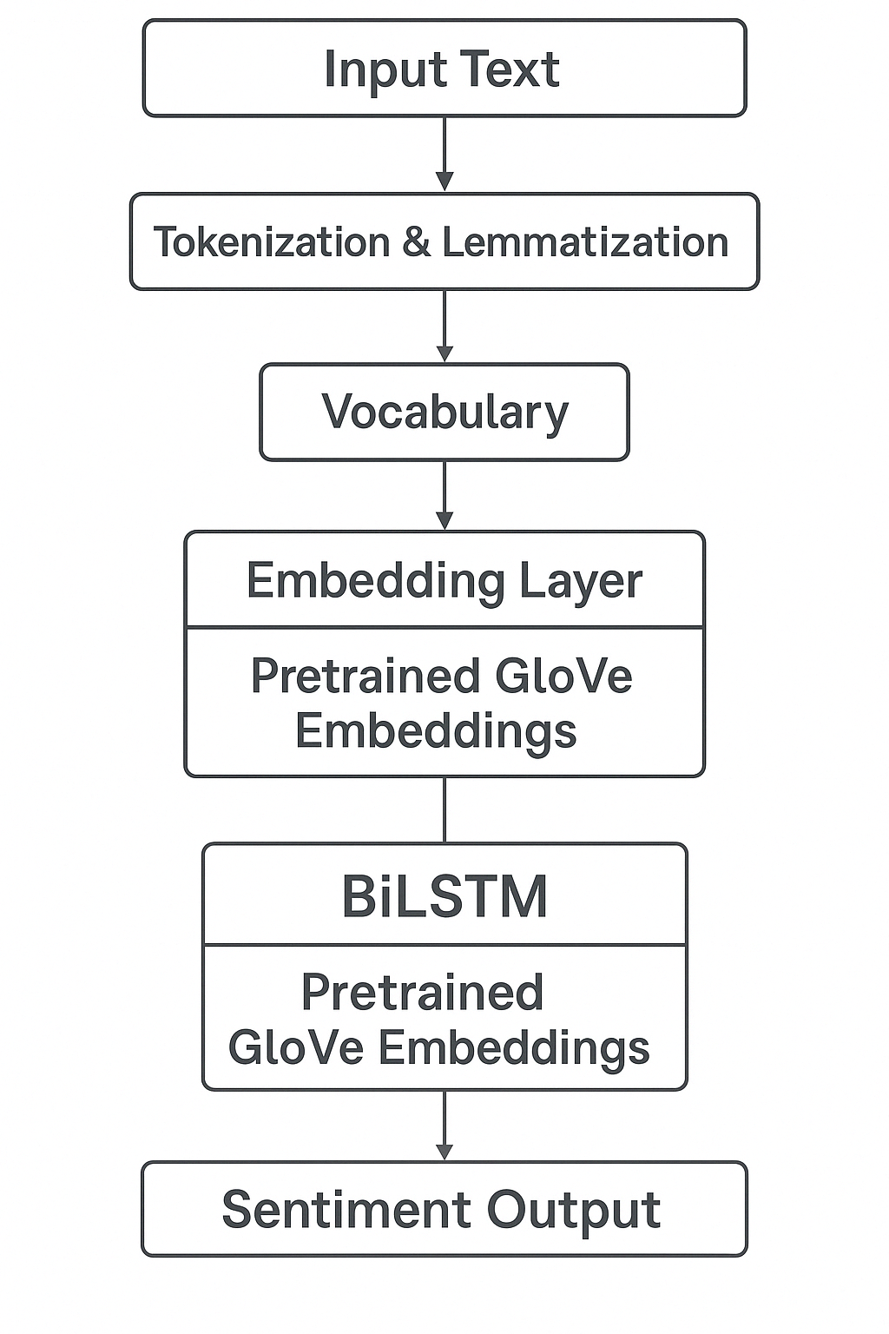
Experiments
Exp 18: Bidirectional LSTM (BiLSTM)
The eighteenth experiment utilized a Bidirectional LSTM (BiLSTM) model to capture information from both past and future context in text.The architecture used frozen 300-dimensional GloVe embeddings, a two-layer bidirectional LSTM with a hidden size of 256 and dropout of 0.5, followed by a fully connected layer for 3-class classification. The model was trained using the Adam optimizer (learning rate 0.0007, weight decay 1e-4) with CrossEntropyLoss for 30 epochs and a batch size of 128, using the combined Yelp and Dynabench dataset. This model showed robust performance across datasets, achieving 69% on Yelp and 64% on the Combined dataset.
BiLSTM Architecture diagram

Slide 27
Results
Test Accuracy (%)
Exp No. | Experiment Name | Yelp Dataset | Dynabench Dataset | Combined Dataset
1 | Using VADER | 53 | 57 | 53
2 | Using AFINN | 52 | 57 | 53
3 | Using SentiWordNet | 43 | 44 | 43
4 | Using TextBlob | 50 | 54 | 51
5 | Naive Bayes from Scratch | 64 | 52 | 57
6 | Multinomial Naive Bayes | 65 | 53 | 57
7 | Logistic Regression 1 | 54 | 49 | 45
8 | Logistic Regression 2 | 60 | 50 | 56
9 | Logistic Regression 3 | 62 | 51 | 57
10 | Random Forest | 62 | 54 | 59
11 | SVM | 66 | 53 | 61
12 | Decision Tree | 55 | 49 | 52

Slide 28
Results
Test Accuracy (%)
Exp No. | Experiment Name | Yelp Dataset | Dynabench Dataset | Combined Dataset
13 | LSTM | 68 | 59 | 62
14 | GRU | 69 | 58 | 63
15 | N-GRAM | 67 | 59 | 62
16 | BERT | 78 | 66 | 70
17 | GPT | 78 | 66 | 70
18 | BiLSTM | 69 | 58 | 64

Slide 29
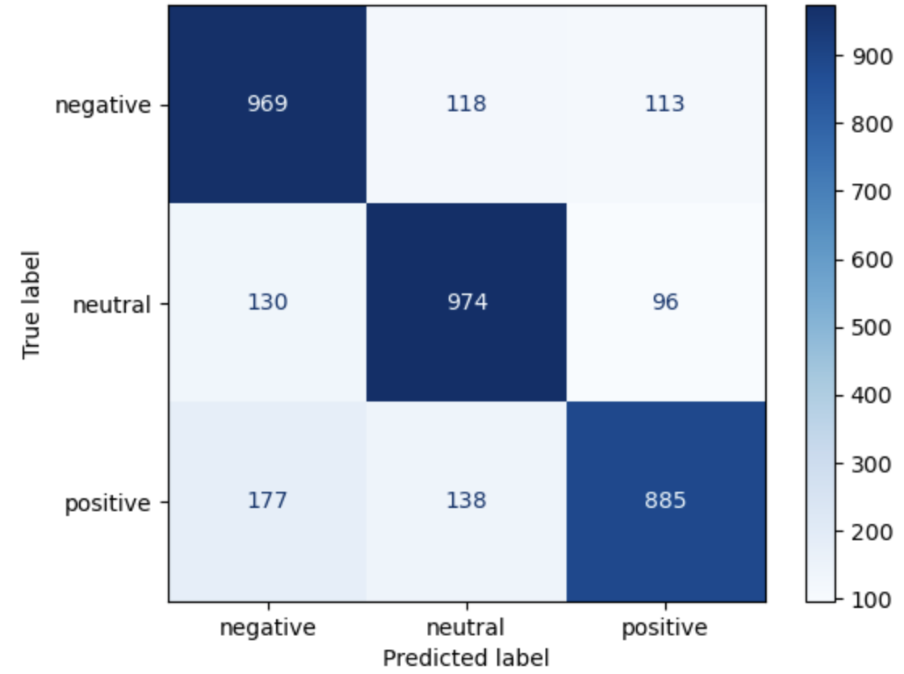
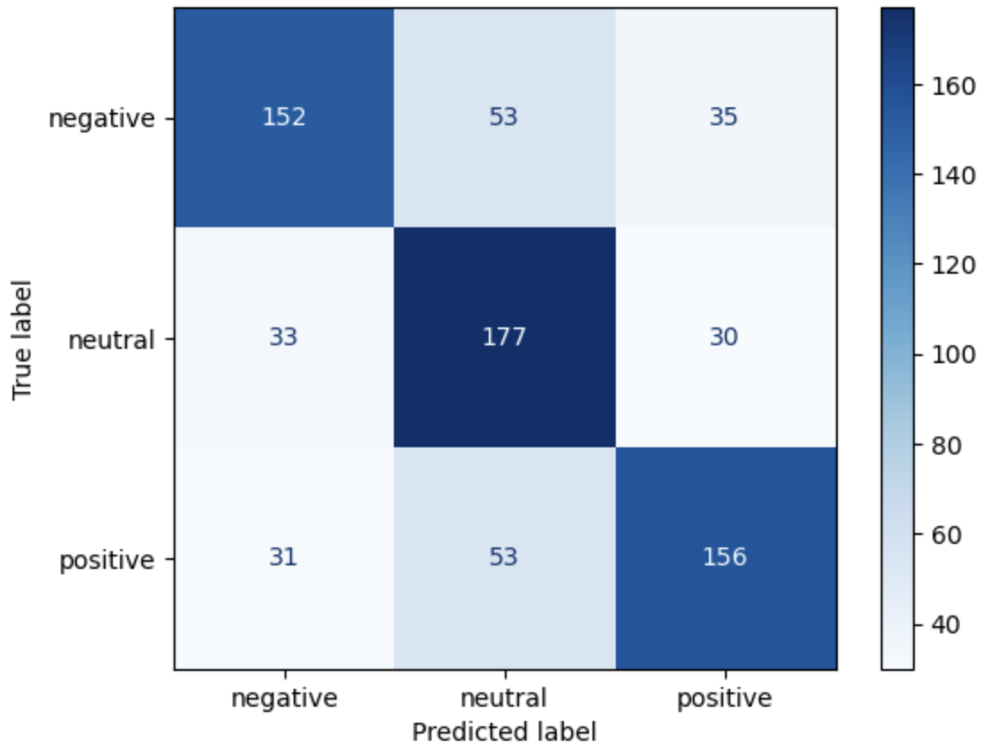
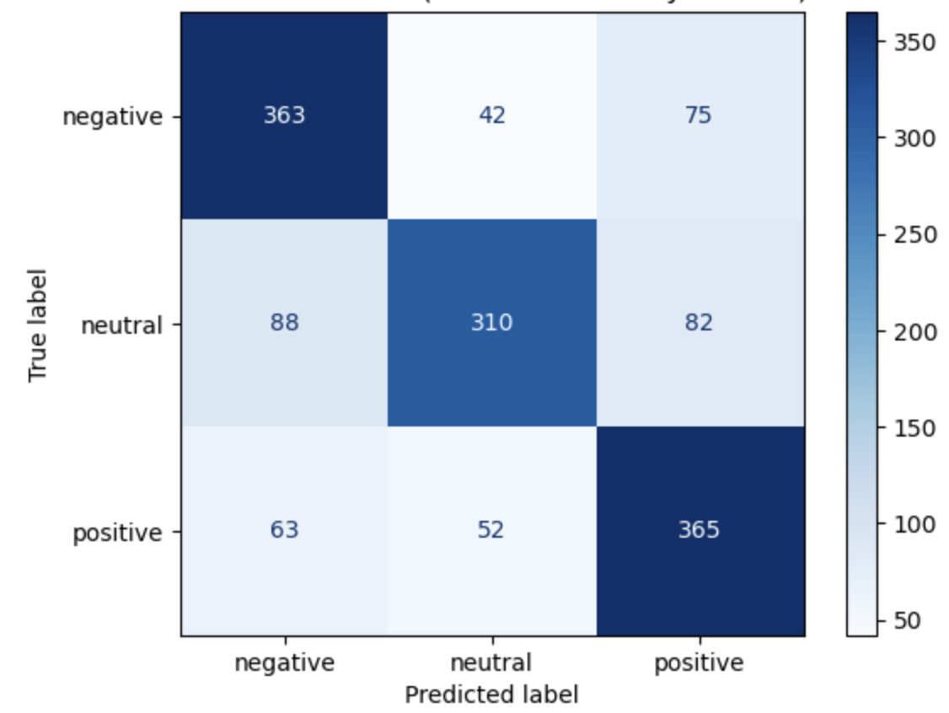
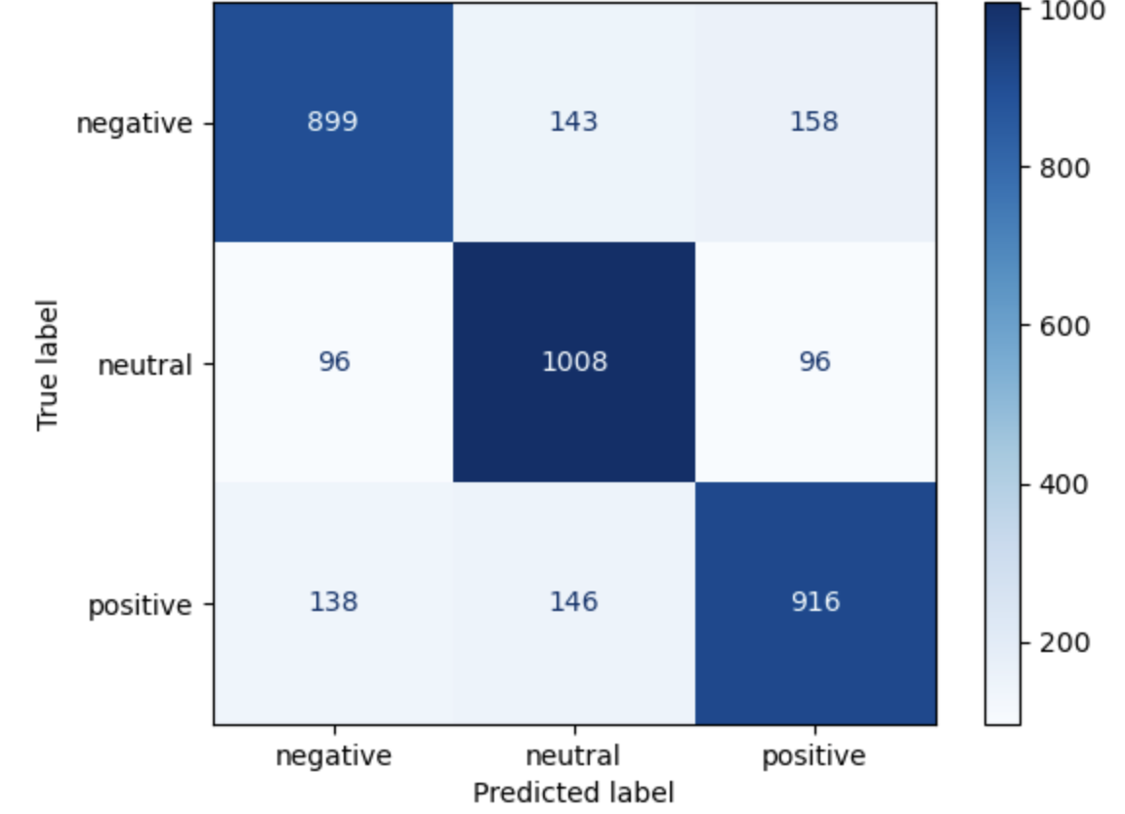
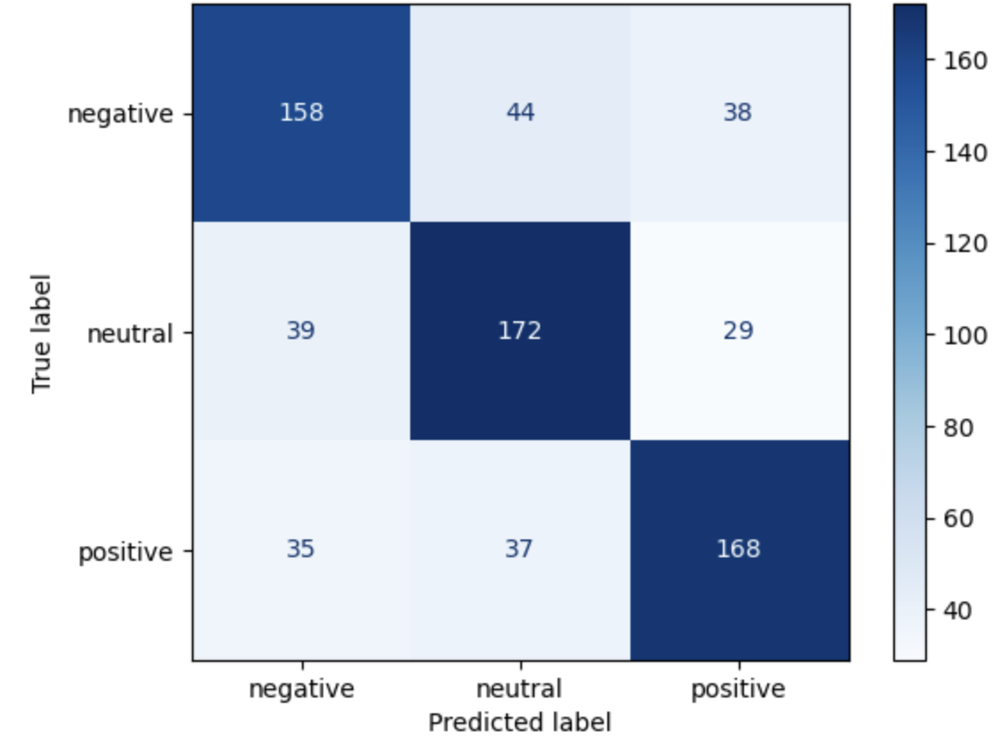
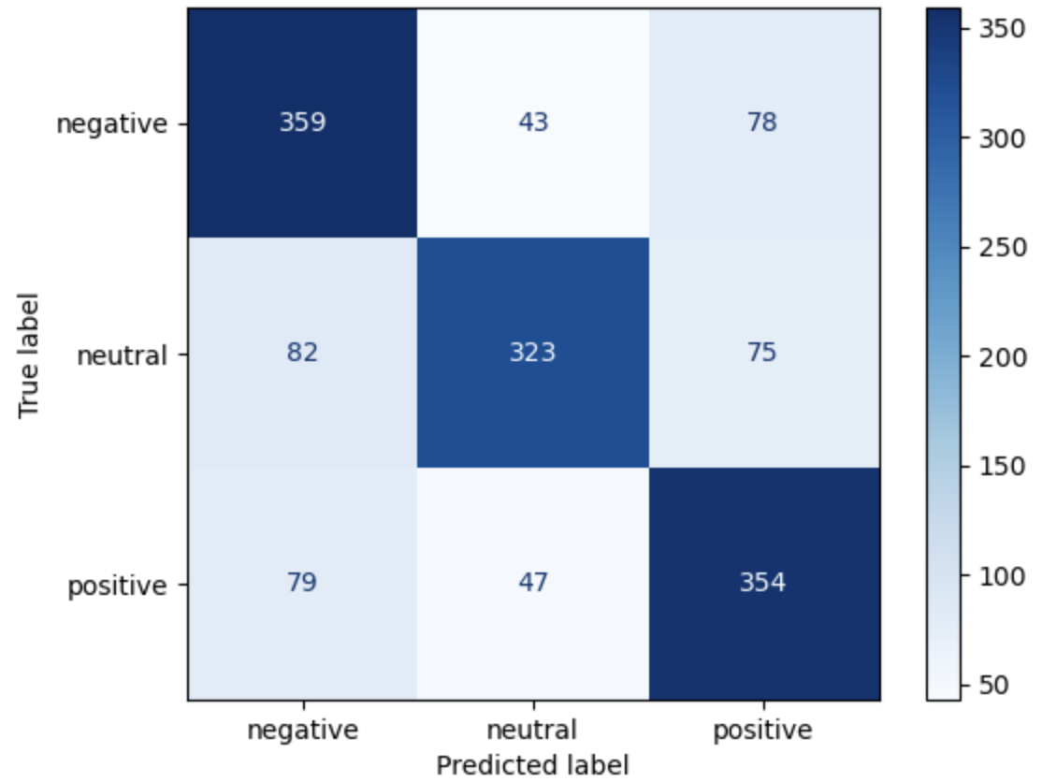
Results
Exp Name | Yelp Dataset | Dynabench Dataset | Combined Dataset
BERT
GPT

Slide 30
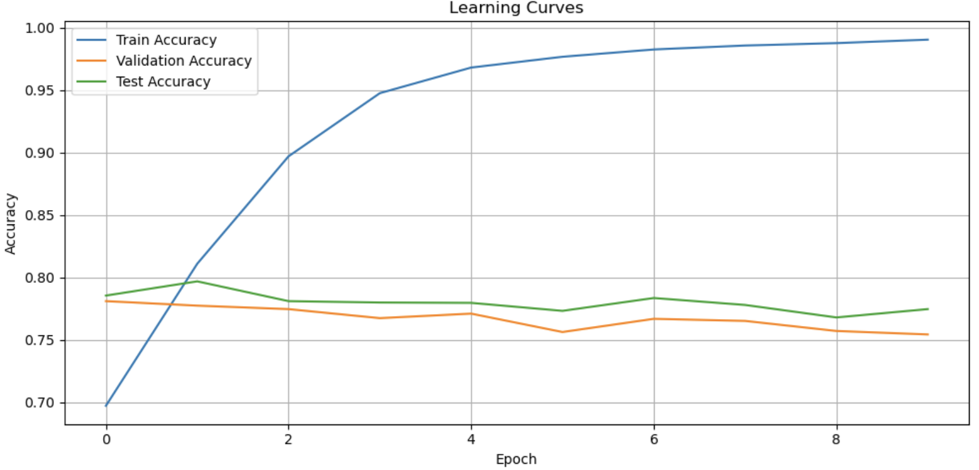
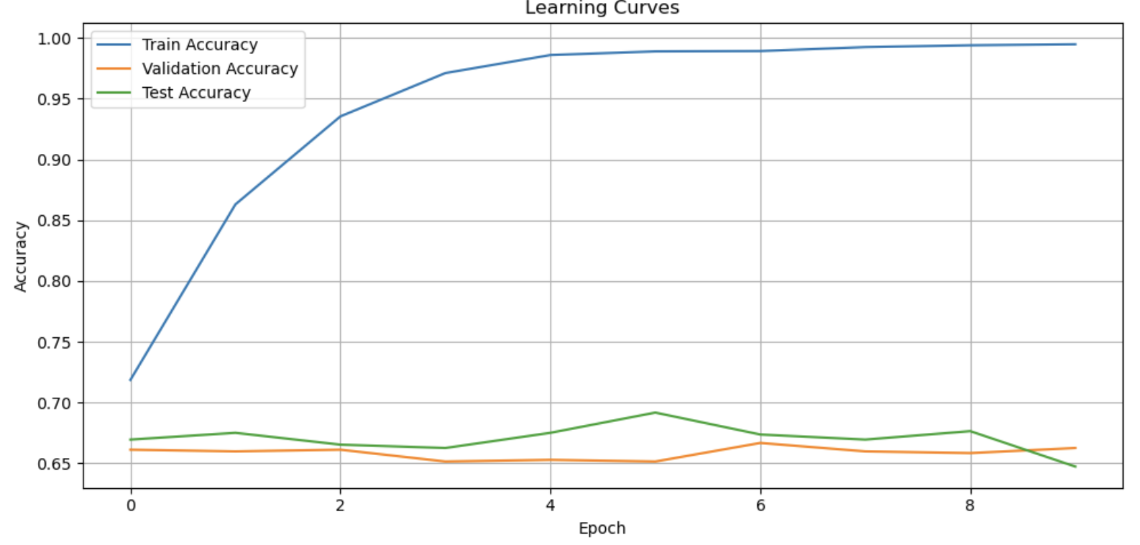
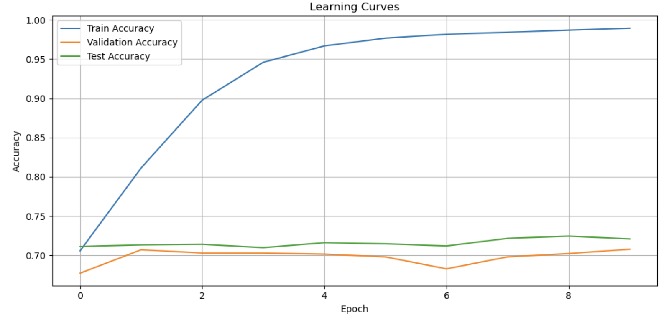
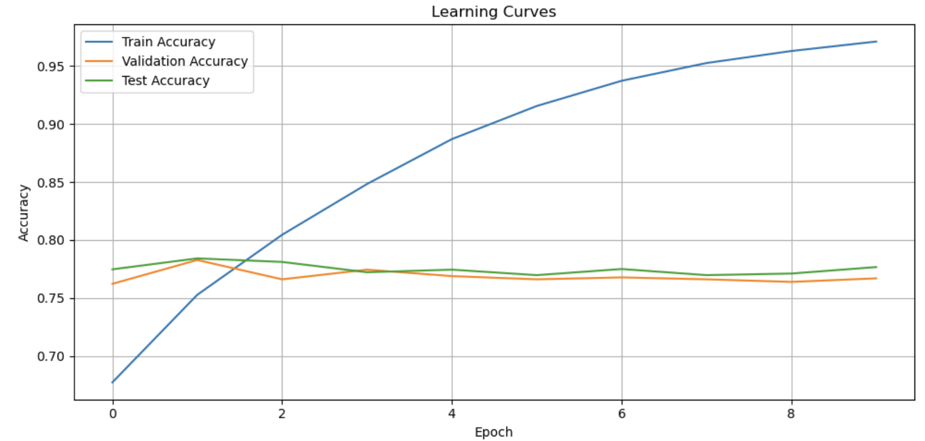
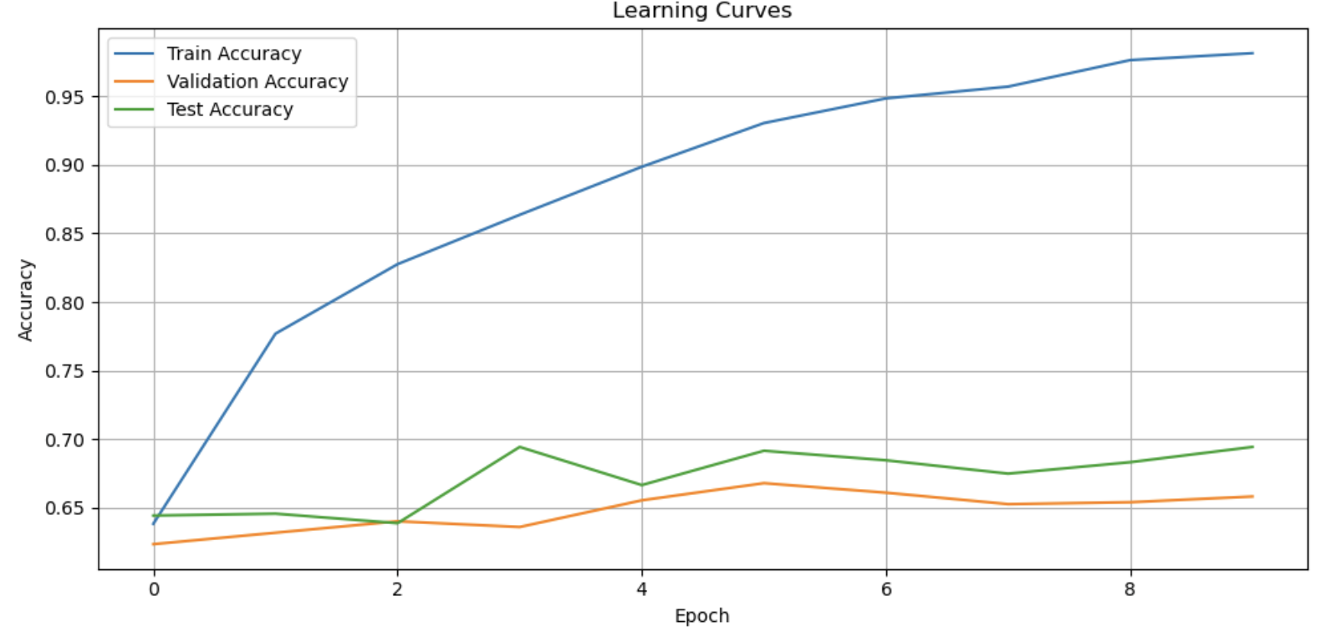
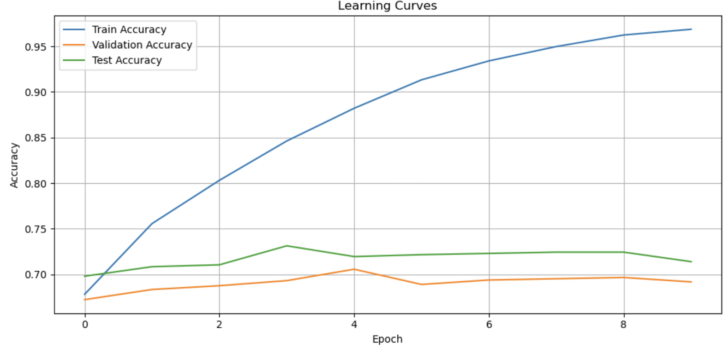
Results
Exp Name | Yelp Dataset | Dynabench Dataset | Combined Dataset
BERT
GPT

Slide 31
Conclusion and Future Directions
This study compared a wide range of sentiment analysis techniques, from lexicon-based and traditional machine learning models to advanced deep learning and transformer architectures.
While lexicon methods offered quick and interpretable results, models like SVM and Logistic Regression performed well with proper preprocessing.
Deep learning models—especially BERT and GPT—achieved the highest accuracy by effectively capturing semantic and contextual features.
For future work, we aim to fine-tune transformer models on domain-specific data, explore attention mechanisms in RNNs, and experiment with ensemble methods for more robust predictions.
Other directions include real-time sentiment classification, expanding to multilingual datasets, and improving model explainability through interpretable AI techniques.

Slide 32
References
[1] C. Hutto and E. Gilbert, "VADER: A parsimonious rule-based model for sentiment analysis of social media text," Proc. Int. AAAI Conf. Web Soc. Media, vol. 8, no. 1, 2014.
[2] B. Liu, "Sentiment analysis," UIC, [Online]. Available: https://www.cs.uic.edu/~liub/FBS/sentiment-analysis.html. [Accessed: Feb. 6, 2025].
[3] B. Pang, L. Lee, and S. Vaithyanathan, "Thumbs up? Sentiment classification using machine learning techniques," arXiv preprint cs/0205070, 2002.
[4] T. Joachims, "Text categorization with support vector machines: Learning with many relevant features," in Proc. Eur. Conf. Mach. Learn., Berlin, Heidelberg: Springer, 1998, pp. 137–142.
[5] J. P. Vink and G. de Haan, "Comparison of machine learning techniques for target detection," Artif. Intell. Rev., vol. 43, pp. 125–139, 2015.
[6] T. Mikolov et al., "Distributed representations of words and phrases and their compositionality," in Adv. Neural Inf. Process. Syst., vol. 26, 2013.
[7] P. Liu, X. Qiu, and X. Huang, "Recurrent neural network for text classification with multi-task learning," arXiv preprint arXiv:1605.05101, 2016.
[8] A. Rakhlin, "Convolutional neural networks for sentence classification," GitHub, vol. 6, p. 25, 2016.
[9] J. Devlin, M.-W. Chang, K. Lee, and K. Toutanova, "BERT: Pre-training of deep bidirectional transformers for language understanding," in Proc. NAACL-HLT, vol. 1, no. 2, 2019, pp. 4171–4186.
[10] T. Brown et al., "Language models are few-shot learners," in Adv. Neural Inf. Process. Syst., vol. 33, 2020, pp. 1877–1901.
[11] C.-L. Chou, C.-H. Chang, and S.-Y. Wu, "Semi-supervised sequence labeling for named entity extraction based on tri-training: case study on Chinese person name extraction," in Proc. Third Workshop Semantic Web Inf. Extraction, 2014.

Slide 33
Q / A

